Slide 1
Sources of American Democracy

Slide 2
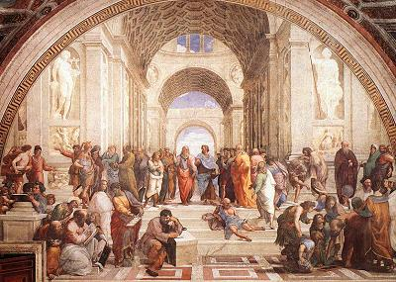
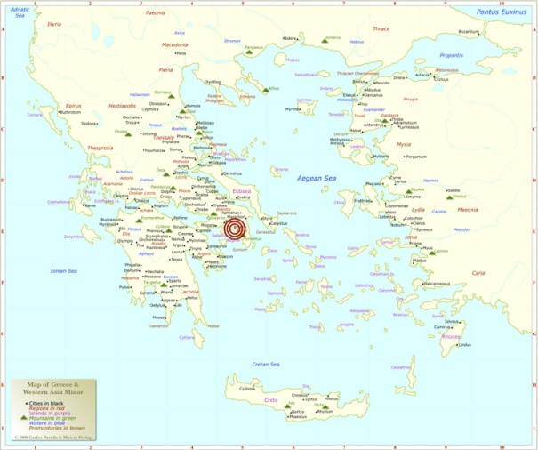
Ancient Athens
All Citizens had a say in Government and voted on big issues

Slide 3
Ancient Athens
First use of “the people rule”, democracy
only men could vote, but not slaves or women
Greek: ‘demos’ = people
‘archy’ = rule of

Slide 4
Magna Carta, 1215 England
First limit on government power
Established many features of law we recognize today

Slide 5
Magna Carta
First Limits on Government
Trial by jury of one’s peers
No loss of property unless found guilty of a crime
Right to see evidence brought against you
Right to bring witnesses to help you
ONLY APPLIED TO NOBILITY

Slide 6
QUICK CHECK
Alexander has decided that the law requiring a registration on carrier pigeon messages is unfair. He is the 14 year old son of an Athenian lawyer. Can he speak before the Assembly?
The Count of Isle of Wight feels the king is going to take away his castle. What can he do?

Slide 7
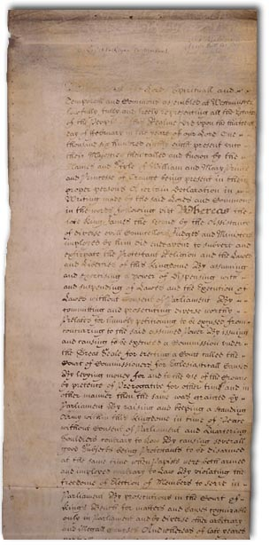
English Bill of Rights, 1689
A statement of rights that citizens and/or residents of a free and democratic society ought to have

Slide 8
English Bill of Rights
Limited Government; equality before law:
Trial by jury of one’s peers
No loss of property unless found guilty of a crime
Right to see evidence brought against you and question witnesses
APPLIES TO ALL ENGLISH CITIZENS

Slide 9
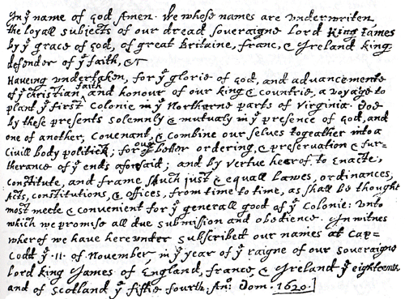
Mayflower Compact
First agreement by English settlers to make their own laws

Slide 10
Mayflower Compact
The ship was outside what they thought was the “legal” settlement area
Decided, with out king’s permission, to set own laws in place
Popular sovereignty or Self –rule; consent of governed

Slide 11
Quick Check
Stephen wants to build his own house. There is no law in Plymouth, Mass. , to prevent this. Is it ok?
Richard is charged with stealing coal to heat his printing office. What says that he can question the witnesses against him?

Slide 12
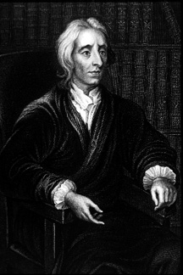
John Locke
Government is a contract between the governors and the governed
Life, liberty, property

Slide 13
Locke
Natural rights of people
Government is contract between governors and the governed.
People may change government/governors if it suits their needs to protect natural rights
Limited government, consent of governed

Slide 14
Reflection
Answer in three to five sentences:
What do we see in the development of government ideals with the examples presented previously?

